Slide 1
Object- Oriented Programming (CS201)
Lecture 8
Encapsulation(2)

Slide 2
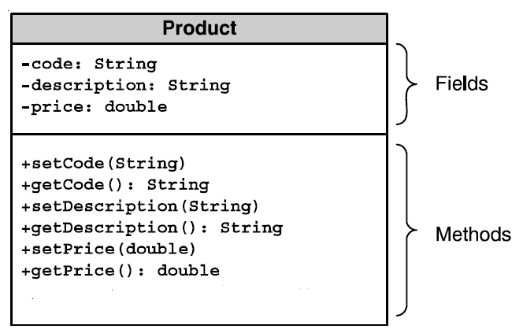
Example : Abstraction of a Product
: private
+:public
# :protected
Add a default empty no-arg constructor to initalize member variables
Add a constructor for instance variable initialization using arguments

Slide 3
public class Product
{
private String code;
private String description;
private double price;
public Product()
{
code = "";
description = "";
price = 0;
}
public Product(String code, String description, double price)
{
this.code = code;
this.description = description;
this.price = price;
}

Slide 4
public void setCode(String code)
{
this.code = code;
}
public String getCode(){
return code;
}
public void setDescription(String description)
{
this.description = description;
}
public String getDescription()
{
return description;
}
public void setPrice(double price)
{
this.price = price;
}
public double getPrice()
{
return price;
}
}

Slide 5
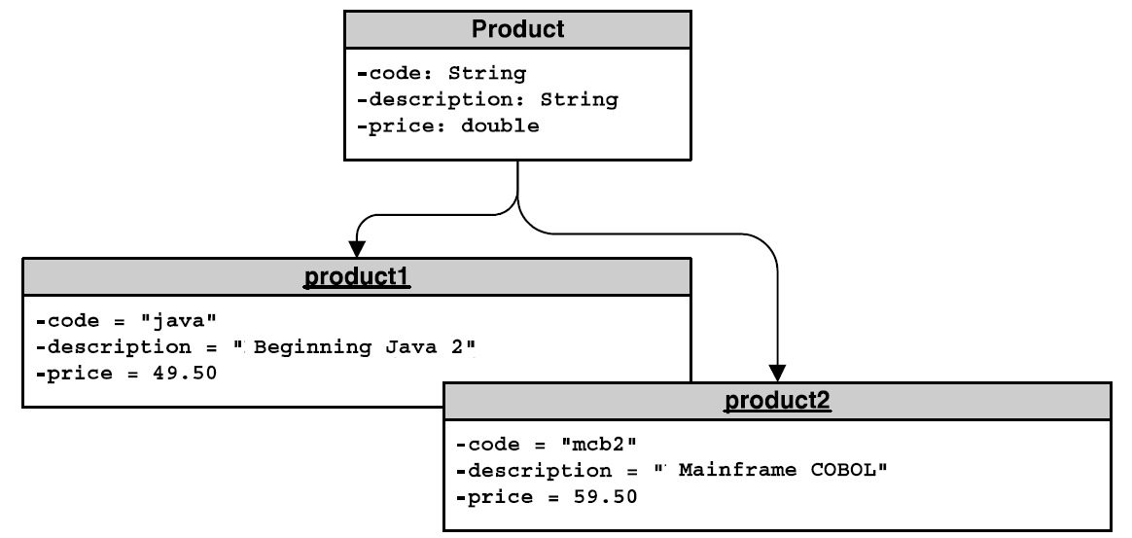
Creating Object of class Product

Slide 6
class Test{
public static void main (String [] arg){
Product product1=new Product();
product1.setCode("Java");
product1.setDescription("Begining Java 2");
product1.setPrice(49.5 );
Product product2=new Product("mcb2","MainFrame Cobol",59.50);
displayProduct(product1);
displayProduct(product2);
}
public static void displayProduct(Product product)
{
String productCode=product.getCode();
String productDescription=product.getDescription();
double productPrice=product.getPrice();
System.out.println("Product code is " +productCode + ", description :"+ productDescription + ", price "+productPrice);
}
}

Slide 7
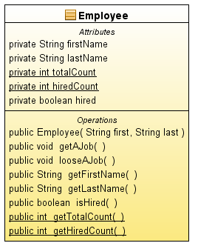
Example : Class Employee
Design a class Employee that encapsulate the concept of Employee.
Each employee has a first name and a last name and a boolean variable (hired) representing whether the employee is hired or not.
2 variables exist to store the total number of employees (totalCount)and total number of hired employees(hiredCount).
Each employee is constructed using his first name and last name.
Class employee has the following methods:
accessor methods for its member variables.
method getAJob () : make an unhired employee hired and increment hired count.
method looseAJob() : make a hired employee not hired and decrement hired count.
In UML static member are denoted by being underlined.

Slide 8
public class Employee {
private String firstName;
private String lastName;
private static int totalCount ;
private static int hiredCount ;
private boolean hired;
public Employee( String first, String last )
{
firstName = first;
lastName = last;
totalCount++;
}
public void getAJob()
{ if(hired) return;
hired=true;
hiredCount++;
}
public void looseAJob()
{ if(!hired) return;
hired=false;
hiredCount--;
}
public String getFirstName()
{
return firstName;
}
public String getLastName()
{
return lastName;
}
public boolean isHired()
{
return hired;
}
public static int getTotalCount()
{
return totalCount;
}
public static int getHiredCount()
{
return hiredCount;
}
}

Slide 9
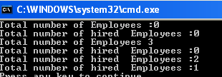
public class TestEmployee
{
public static void main (String [] arg)
{
System.out.println("Total number of Employees :"+Employee.getTotalCount());
System.out.println("Total number of hired Employees :" +Employee.getHiredCount());
Employee emp1=new Employee("Ahmed", "Aly");
Employee emp2=new Employee("Mohamed", "Mansour");
Employee emp3=new Employee("Fathi", "Ahmed");
System.out.println("Total number of Employees "+Employee.getTotalCount());
System.out.println("Total number of hired Employees :" +Employee.getHiredCount());
emp1.getAJob();
emp2.getAJob();
System.out.println("Total number of hired Employees :" +Employee.getHiredCount());
emp2.looseAJob();
System.out.println("Total number of hired Employees :" +Employee.getHiredCount());
}

Slide 10
Access Control
Java provides several modifiers that control access to data fields, methods, and classes
public makes classes, methods, and data fields accessible from any class.
private makes methods and data fields accessible only from within its own class.
If no access modifier is used, then by default the classes, methods, and data fields are accessible by any class in the same package. This is known as package-access.
If protected is used, then that member can be accessed by own class and classes from same package and from subclass outside the package .
public int i;
private double j;
public void m (){}
int x;
The default constructor has the same access as its class
Local Variables can not have an access modifier
Notes:
C#
-The following five accessibility levels can be specified using the access modifiers:
public protected internal internal protected private
-the default of a class or interface is internal , foe a member is private

Slide 11
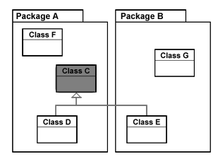
The Different Levels of Access Control
private | default | protected | public | Visibility
 |  |  |  | From the same class
 |  |  |  | From any class in the same package
 |  |  |  | From any class outside the package
 |  |  |  | From a subclass in the same package
 |  |  |  | From a subclass outside the same package
Yes
Yes
Yes
Yes
Yes
Yes
Yes
No
Yes
No
No
No
Yes
Yes
Yes
No
Yes
Yes
No
No
Access modifiers apply to class members (variables and methods) and constructors too.
Class D,E subclasses of class C

Slide 12
Designing the Loan Class
Loan
TestLoan

Slide 13
Class Loan
public class Loan
{
private double annualInterestRate;
private int numberOfYears;
private double loanAmount;
private java.util.Date loanDate;
/** Default constructor */
public Loan() {
this(2.5, 1, 1000); }
/** Construct a loan with specified annual interest rate, number of years and loan amount */
public Loan(double annualInterestRate, int numberOfYears, double loanAmount) {
this.annualInterestRate = annualInterestRate;
this.numberOfYears = numberOfYears;
this.loanAmount = loanAmount;
loanDate = new java.util.Date();
}

Slide 14
Class Loan……
/** Return annualInterestRate */
public double getAnnualInterestRate() {
return annualInterestRate; }
/** Set a new annualInterestRate */
public void setAnnualInterestRate(double annualInterestRate)
{
this.annualInterestRate = annualInterestRate; }
/** Return numberOfYears */
public int getNumberOfYears() {
return numberOfYears; }
/** Set a new numberOfYears */
public void setNumberOfYears(int numberOfYears) {
this.numberOfYears = numberOfYears; }
/** Return loanAmount */
public double getLoanAmount() {
return loanAmount; }

Slide 15
Class Loan……
/** Set a newloanAmount */
public void setLoanAmount(double loanAmount) {
this.loanAmount = loanAmount;
}
/** Find monthly payment */
public double getMonthlyPayment() {
double monthlyInterestRate = annualInterestRate / 1200;
double monthlyPayment = loanAmount * monthlyInterestRate / (1 - (Math.pow(1 / (1 + monthlyInterestRate), numberOfYears * 12)));
return monthlyPayment; }
/** Find total payment */
public double getTotalPayment() {
double totalPayment = getMonthlyPayment() * numberOfYears * 12; return totalPayment; }
/** Return loan date */
public java.util.Date getLoanDate() {
return loanDate; }
}

Slide 16
Class TestLoan
import java.util.Scanner;
public class TestLoan {
/** Main method */
public static void main(String[] args) {
// Create a Scanner
Scanner input = new Scanner(System.in);
// Enter yearly interest rate
System.out.print(
"Enter yearly interest rate, for example, 8.25: ");
double annualInterestRate = input.nextDouble();
// Enter number of years
System.out.print("Enter number of years as an integer: ");
int numberOfYears = input.nextInt();
// Enter loan amount
System.out.print("Enter loan amount, for example, 120000.95: ");
double loanAmount = input.nextDouble();

Slide 17
Class TestLoan…………..
// Create Loan object
Loan loan =
new Loan(annualInterestRate, numberOfYears, loanAmount);
// Display loan date, monthly payment, and total payment
System.out.printf("The loan was created on %s\n" +
"The monthly payment is %.2f\nThe total payment is %.2f\n",
loan.getLoanDate().toString(), loan.getMonthlyPayment(),
loan.getTotalPayment());
}
}
Hint:
printf works the same as in C programming language
Method toString() in class java.util.Date returns a string representation of the date object

Slide 18
The BMI Class
BMI
UseBMIClass
Run

Slide 19
Code
Directory: BMI Calculator
Source Files:
BMI.java
UseBMI.java
Program source file is too big to list here. From now on, we ask
you to view the source files using your Java IDE.
Notes:
Please use your Java IDE to view the source files and run the program.

Slide 20
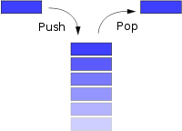
Case Study: Stack
Design a java class that encapsulate the data structure Stack ( Last in First out).
The class has 2 methods
(push) : method for adding items to stack, the push operation adds items to the top of the list
(pop) :method for retrieving items from the stack, . The pop operation removes an item from the top of the list, and returns its value to the caller.
in the case of overflow the user should be informed with a message
in the case of underflow, the user should be informed with a message & a value of zero is returned.
Assumptions : The stack will hold up to 10 +ve integer values.

Slide 21
Class Stack
/* This class defines an integer stack that can hold 10 values*/
class Stack {
private int stck[] = new int[10];
private int tos;
Stack() {
tos = -1;
}
// Push an item onto the stack
public void push(int item) {
if(tos==9)
System.out.println("Stack is full.");
else
stck[++tos] = item;
}
// Pop an item from the stack
public int pop() {
if(tos < 0) {
System.out.println("Stack underflow.");
return 0;
}
else
return stck[tos--];
}
}

Slide 22

class TestStack {
public static void main(String args[]) {
int element;
Stack mystack1 = new Stack();
// push some numbers onto the stack
mystack1.push(1);
mystack1.push(17);
//mystack1.stck[3]=4 compile error call is encapsulated stck is private
mystack1.push(20);
// pop some numbers off the stack
element=mystack1.pop();
System.out.println("Element is "+element);
element=mystack1.pop();
System.out.println("Element is "+element);
}
}
Notes:
Without enapsulation Stack class.
for the array that holds the stack, stck, to be altered by code outside of the Stack class. ex mystack1.stck[3]=4;
This leaves Stack open to misuse (encaspulation not met)

